Slide 1
SYSTEM DEVELOPMENT LIFE CYCLE

Slide 2
The System Development Life Cycle is the process in which the
information systems, specially the computer based information systems
are developed .
The process involves different phases of development. They are
Feasibility Study
Planning and analysis,
Requirement
Design
Implementation or Coding
Testing
Deployment
Maintenance
The SDLC is also known as Information System Development or
Application Development.

Slide 3
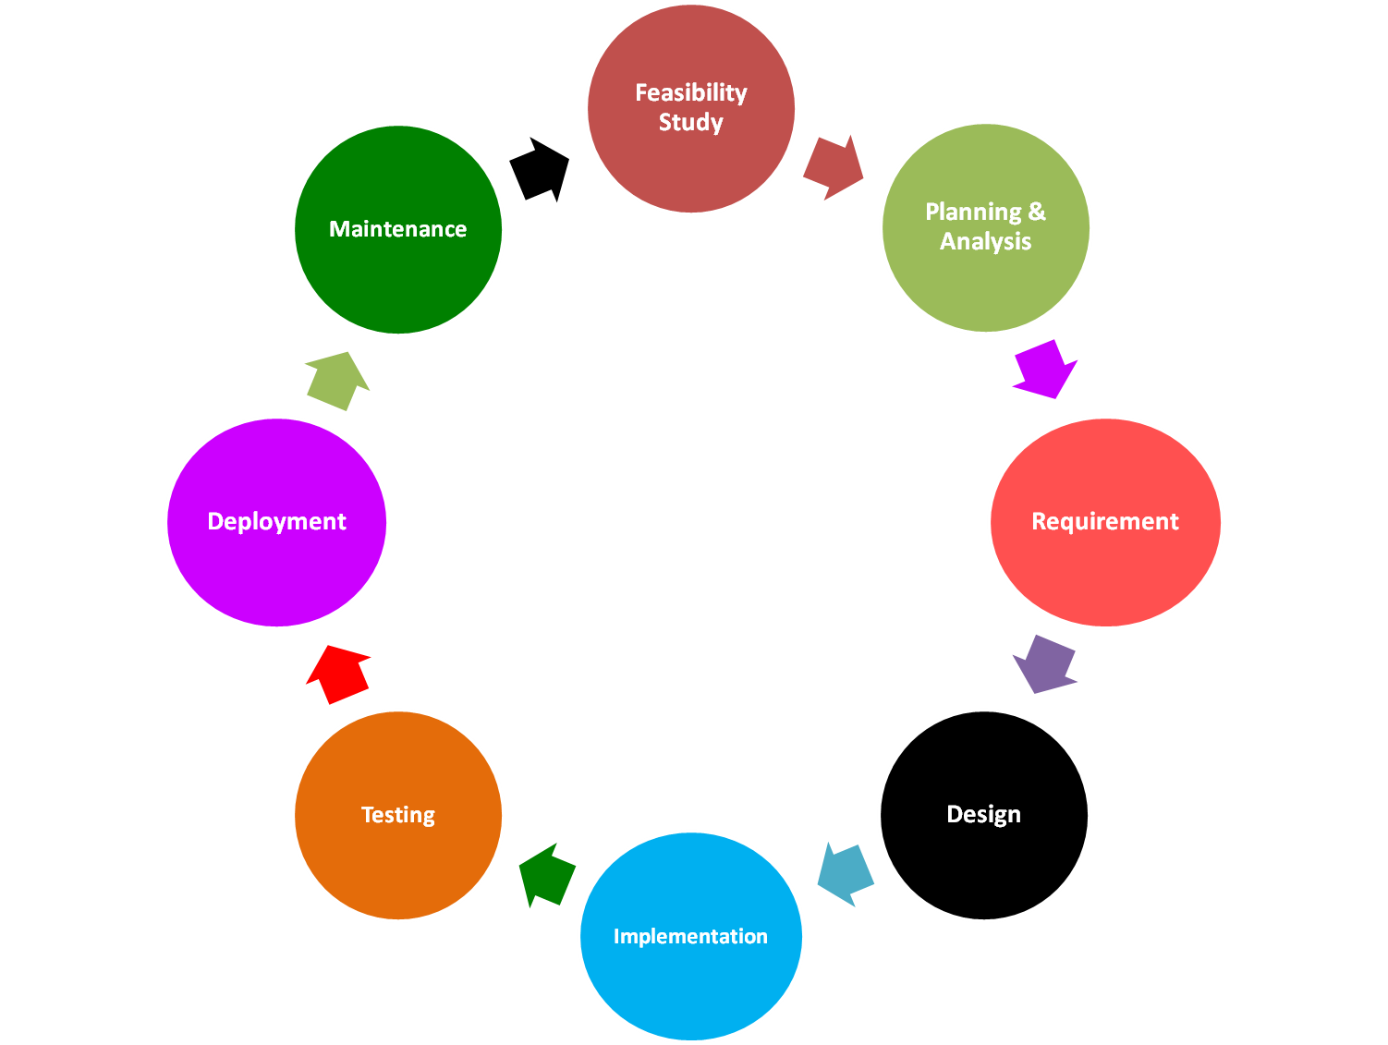


Slide 4
Feasibility Study
The objective of the feasibility study is to assure alternative systems
so that the most feasible system for the development process can be
proposed.
This phase is basically about answering the following questions:-
1. Can this system meet the business requirement needs?
2. Is this system development system or process suitable/useful?
3. What are the risks involved in this system?
4. Is the problem associated with the system worth solving?

Slide 5
Planning and Analysis
The Planning Phase is the first phase of the SDLC.
In this phase the actual problem or the goal of the system and its
feasibility is being analyzed.
Once the goal is analyzed, planning is done with the team of experts on
how to achieve this goal.
Planning provides the basis for acquiring the resources needed for the
system to achieve the goal.
During this phase, the group that is responsible for creating the system
must first determine what the system needs to do for the organization
(requirements gathering).

Slide 6
Often this means asking questions such as...
What do we need this system for?
What will the system do for the organization?
How are we going to make this system?
During this initial phase, resources (both human and technology resources) are put together and a project plan is devised by the project manager.
Cost-benefit Analysis is also done in this phase.
Cost-benefit Analysis is an analysis of the cost effectiveness of different alternatives in order to see whether the benefits outweigh the costs, and by how much .

Slide 7
Requirement
Requirement Analysis is the second phase of SDLC.
It is done to gather all the resources required to fulfill the goal of the system to be developed.
Whenever the system is required to be changed, it should be known that what is needed or what is required for implementing the change in the system.
The requirement analysis of the system is performed by:
Development of SRS (Software Requirement Specification) or Full Documentation of the Project.

Slide 8
SRS includes-a) Functional Requirements
b) Non- Functional Requirements
c) Goals of Implementation
Functional Requirements- It discusses the functionalities required from the system. The functional requirement of the system as documented in the SRS should clearly specify each function that the system would support.
Non- Functional Requirements- It deals with the characteristics of
the function that cannot be expressed as functions. Example include
Reliability issues, security issues, availability, accuracy of the result, constraints on the system, etc.
Goals of Implementation- It gives some general suggestion regarding further development. It might document issues such as revision of system functionalities, future developments, reusability issues, etc.

Slide 9
Interviews of the people or employees concerned.
Surveys or different observations.
Examination of reports, documents, manuals, etc.

Slide 10
Design
In the design phase, all the features, functions and operations are
described in terms of diagrams such as process diagrams, flow
diagrams, relationship diagrams, etc.
Data flow diagram is a type of Flow diagram and E-R Diagram is a
type of diagram used in setting up relationship between different
entities.

Slide 11
Implementation
This phase is sometimes called the development phase.
In this phase programming or coding is being done to implement or
execute design, using suitable programming tool or language.
In this stage, initially it is decided that which programming tool or
environment should be used to develop the software.
Once the tool is decided, all modules are divided and assigned to
different experts so that they can be implemented on the system.

Slide 12
Testing
Once the project or system is completed , it is tested on different
frameworks and systems to identify the compatibility.
The source code or program is tested at various levels.
During testing and integration stage, test data is migrated from the
development environment to the test environment.
Here all test cases are executed to verify the correctness and
completeness of the software.
Successful execution of test plan confirms that the project is having
a robust and complete migration capability.

Slide 13
Deployment
Deployment starts after the code is appropriately tested and approved
for release or sold or otherwise distributed in a production environment.
In the deployment phase, the software is installed in the system and
users are trained in its operation.

Slide 14
Maintenance
This Phase includes the life of the system which includes
modifications, updation, changes and enhancements.
Time to time new changes are implemented in the system as per new
requirements and features of the user along with fixing the errors if
existed.

